Slide 1

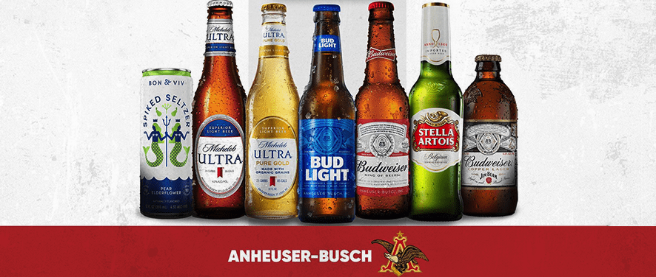
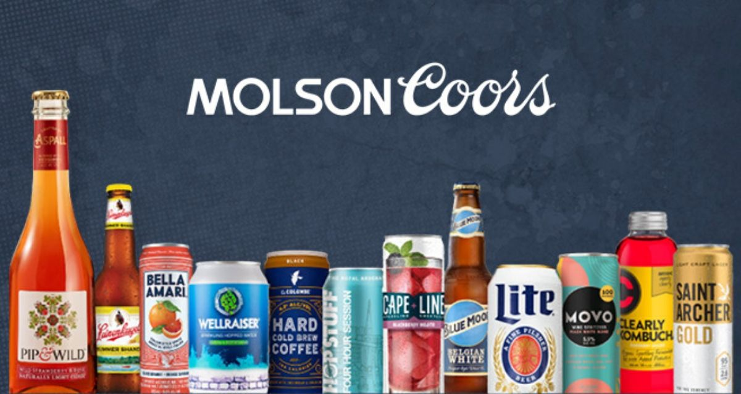
Anheuser-Busch InBev vs. Molson Coors
Integrated Report
Matthew Ranshaw
Stephanie Guy
Clio Clay
Ryan Monk
Justin Archer
Michael Parrino
Matt Winesette

Slide 2
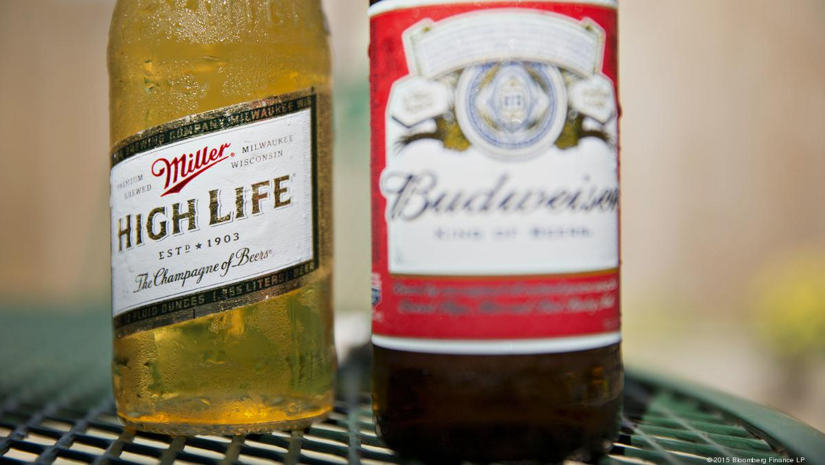
Introduction
Both Anheuser-Busch and Molson Coors are within the Wholesale-Beer, Wine & Distilled Alcoholic Beverages industry
They have similarities and differences when it comes to their strategic business decisions affecting both their internal and external analysis

Slide 3
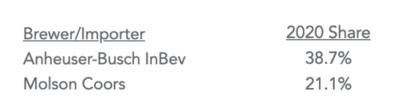
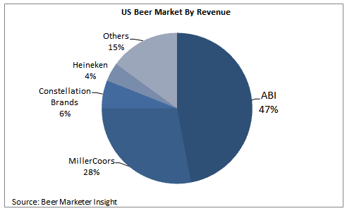
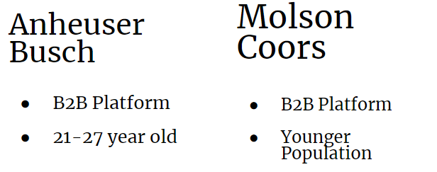
Strategic Competitors
Top US Beer Market Share which makes them direct competitors
Top Revenue in US Beer Market
They share the same target customers and business platform

Slide 4
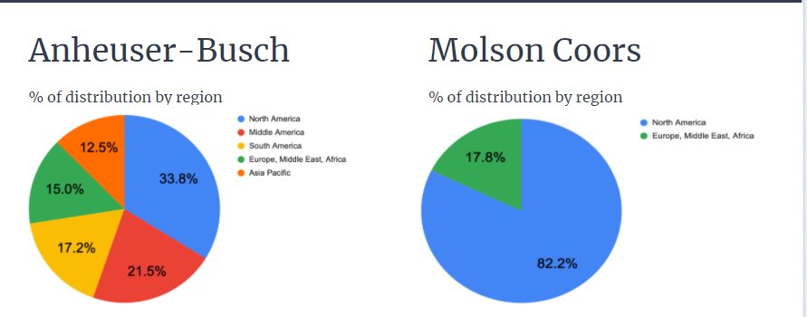
External Environment Analysis
Target demographics are similar with the 2 companies with their top brands focusing on 21-24 year olds
Economic Profiles for the companies show Molson is more focused on environment while AVB more focused on labor markets
Political/Legal Environments affect both companies equally such as age requirements of consumption and regulations of days and time when alcohol can be sold

Slide 5
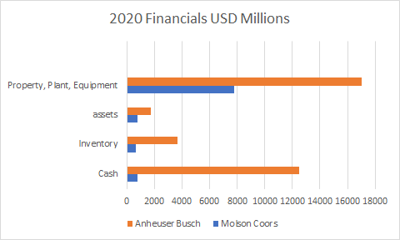
Competitive Advantage Analysis
Anheuser - Busch out does Molson Coors in every single financial category that matters, when it comes to physical categories like independent distributors, Molson Coors wins
Anheuser - Busch leads in reputation as well, of the top 10 most sold beers in the US, Anheuser - Busch has 6 to Molson Coors 2
Molson Coors is all about efficiency and sustainability where is Anheuser is about marketing and broadening their product line
Both companies excel in sponsoring and getting their names out there with Bud light(Anheuser Busch) and Coors Light(Molson Coors) being the beers of the NFL and NHL respectively

Slide 6
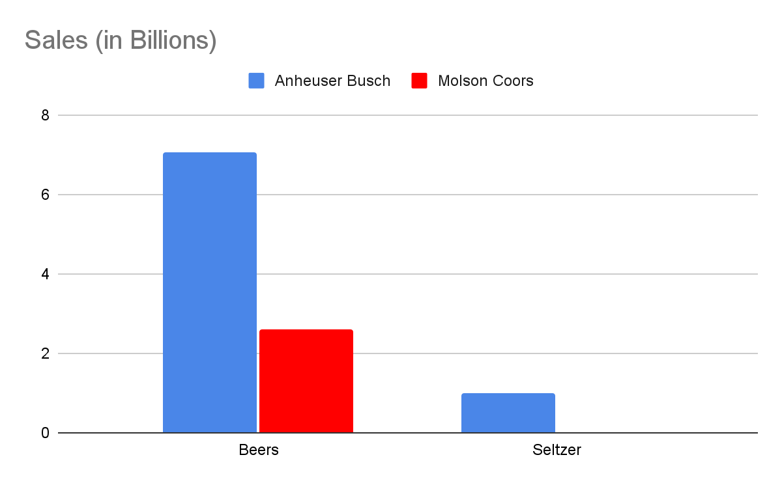
Business Strategy Analysis
Molson Coors and Anheuser Busch are the top 2 direct competitors in the beer industry, Anheuser Busch at the moment is much bigger in sales
Their selling points are essentially the same even when it comes to the seltzer lines of each company
Molson Coors has always kept their prices low to satisfy their customers, Anheuser Busch since 2016 has steadily been dropping cost price to satisfy their customers as well
Business Strategy:
Anhesuer Busch: Low operating costs, Marketing, Leverage
Molson Coors: Expansion, investing in infrastructure, streamlining organizational structure

Slide 7
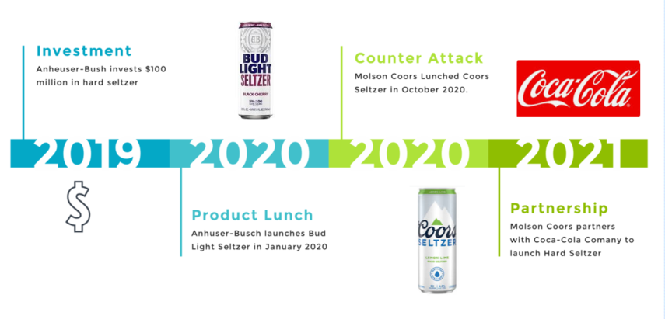
Competitive Dynamics Analysis
Anheuser-Busch launches brand new Seltzer product (2019)
Directly catered to consumer demand for a “healthier beverage”
Obtained a 9% market share in the Seltzer market
Molson Coors launches Seltzer 10-months later gaining 6% market share and eroding Anheuser-Busch from 9% to 7%
Both companies are attempting new advantages in sustainability

Slide 8
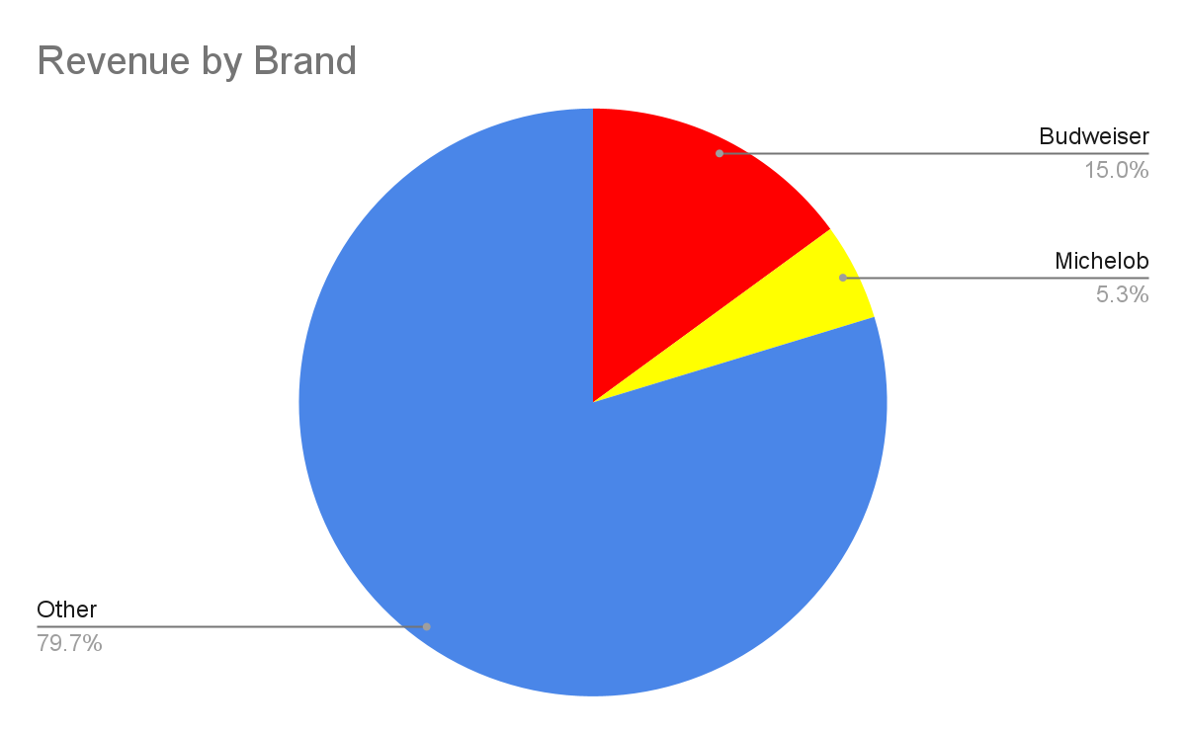
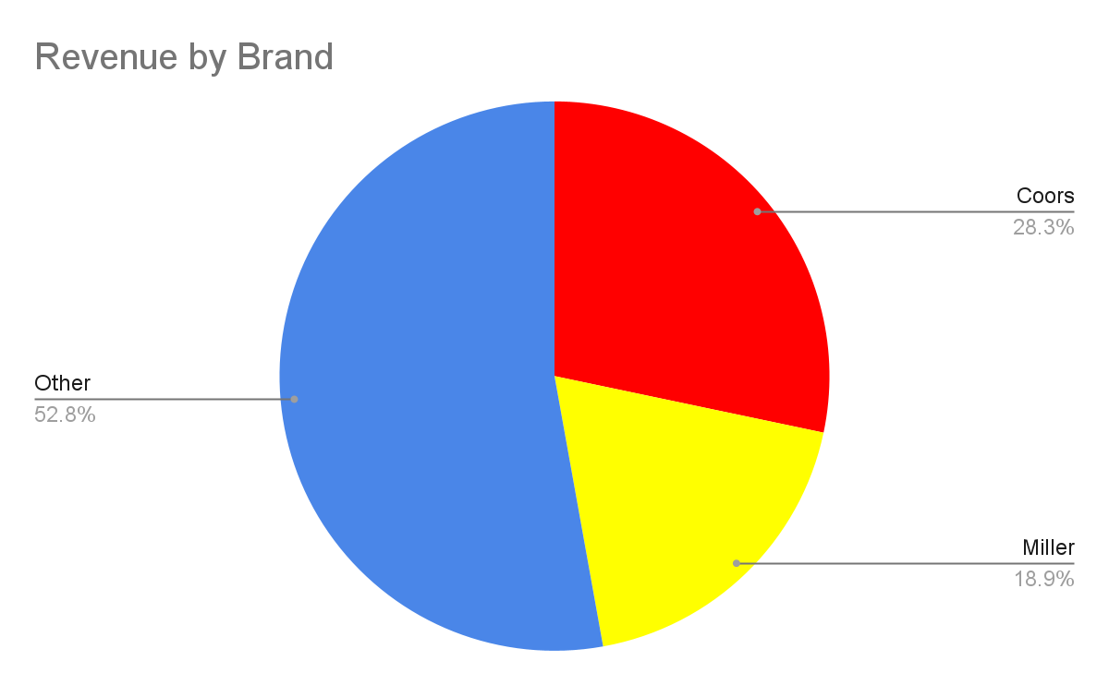
Corporate Strategy Analysis
Anheuser-Busch
Molson Coors
Anheuser-Busch
About 20% of revenue comes from 2 beers (Budweiser and Michelob)
Degree of Relatedness: 14.96%
Molson Coors
About 50% of revenue comes from 2 beer (Coors and Miller)
Degree of Relatedness: 30%
Beers for both companies are brewed at their own breweries (Related Constrained)
Notes:
Busch revenue - 46.8 billion 2 beer = 9.5 billion
Molson revenue - 10.6 billion 2 beers = 5 billion
Busch products: 500
Molson products: 80
Related Constrained: less than 70% of revenue comes from 1 product and main common link among products is the Brewery
Same corporate strategy

Slide 9
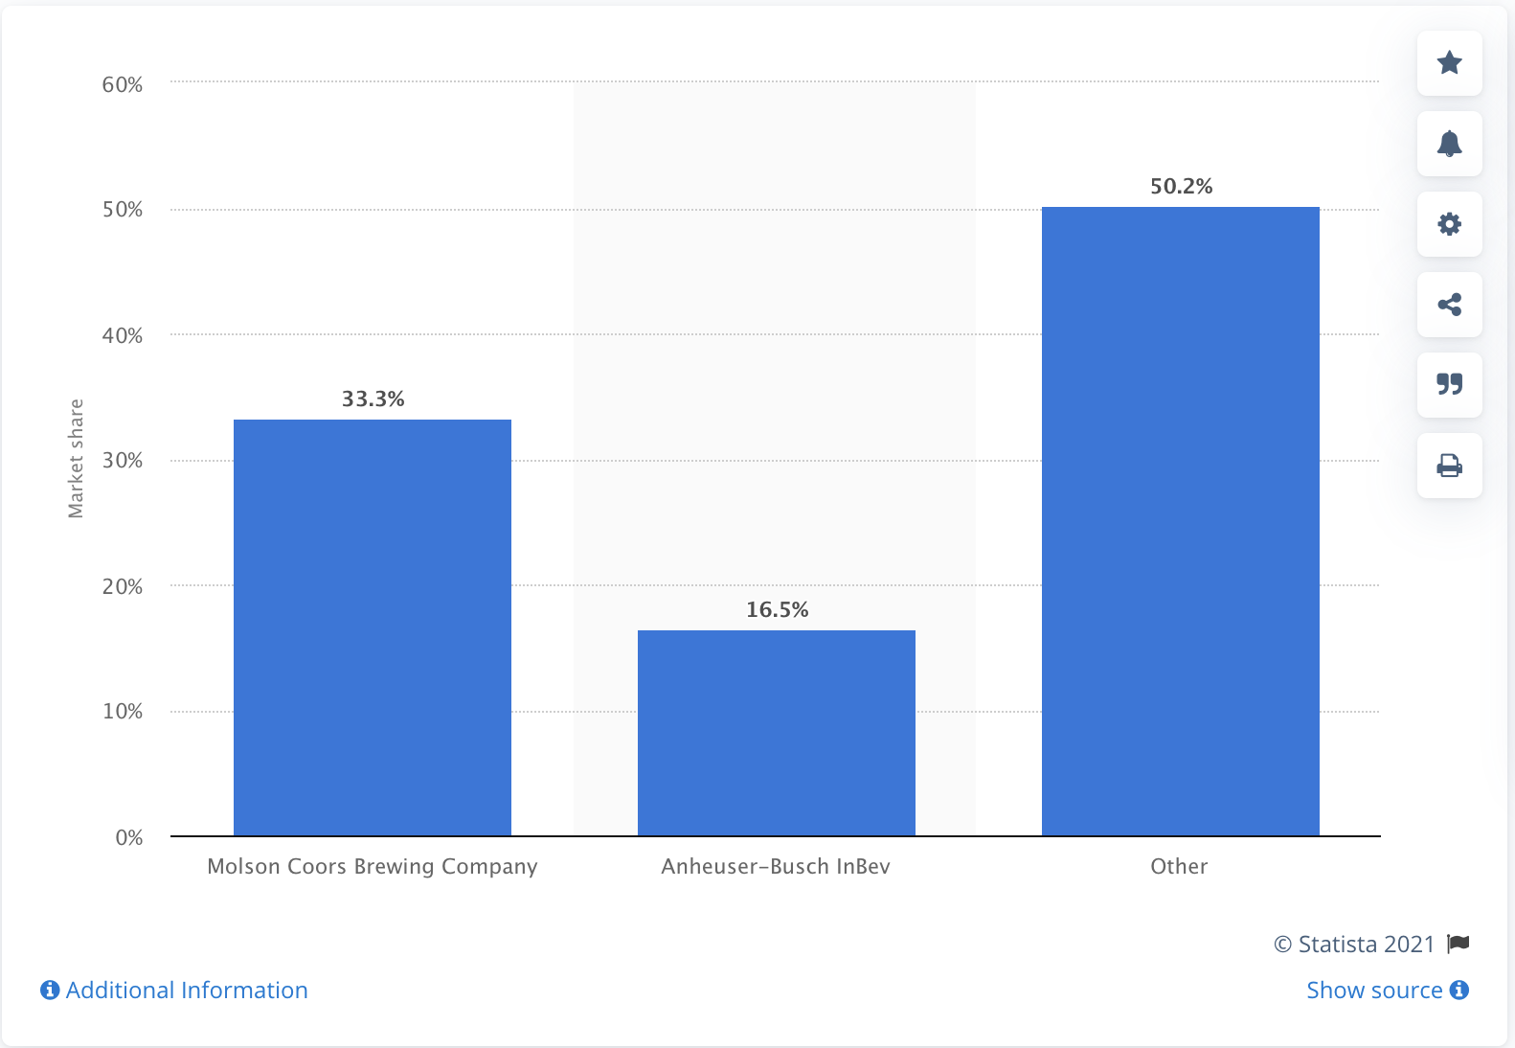
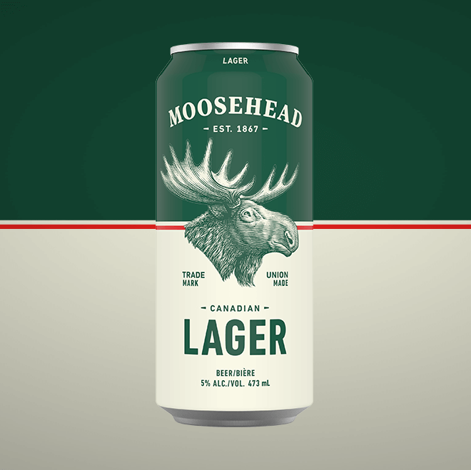
M&A Analysis
Canadian Beer Market Share
If Molson Coors were to acquire Moosehead Breweries it would give them a larger market to sell too.
They currently own 33.3% of the Canadian market share
This acquisition would add about 4% market share to Molson Coors
Moosehead beer is Canada’s oldest and largest independent brewery tracing all the way back to 1867.
Will add an older generation to the current customer group
Acquisition will add a desired Canadian line
Notes:
Molson Coors is at a competitive disadvantage due to a decline in beer volume sales in key markets.
Termination of Joint Ventures
Miller Brewing terminated Canadian License Agreement
Net Sales Declined 8.7% in 2020 and 9.7% in 2021
Then Slide details

Slide 10
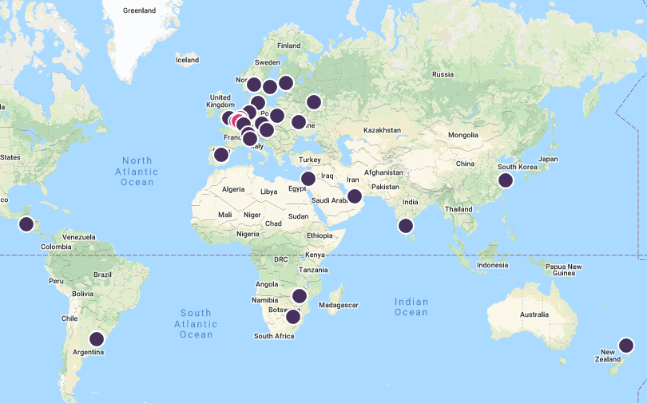
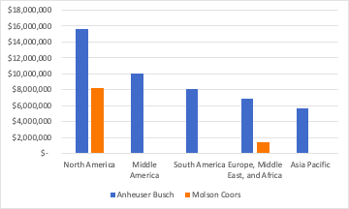
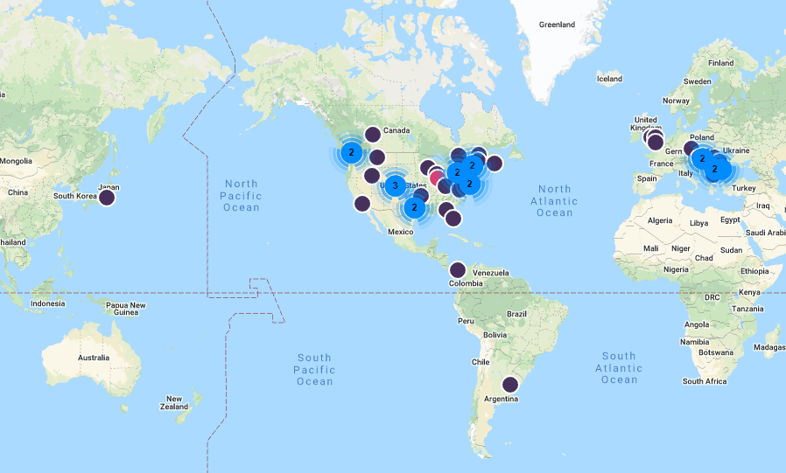
International Strategy
Anheuser-Busch
International operations generates almost 70% of revenue for Anheuser Busch.
Anheuser- Busch is headquartered in Bruxelles, Belgium.
30 office locations in 27 countries with 163,695 global employees.
Home Replication- The strategies and subsequent competencies they’ve developed at home are what they use in markets across the globe.
Molson Coors
International operations generates only about 32% of revenue for Molson Coors.
Headquartered in Chicago, Illinois and has 47 office locations across 10 countries with 17,000 global employees.
Transnational Strategy- Coors is focused on advancement and streamlined technology as a way to grow their products in the industry.

Slide 11
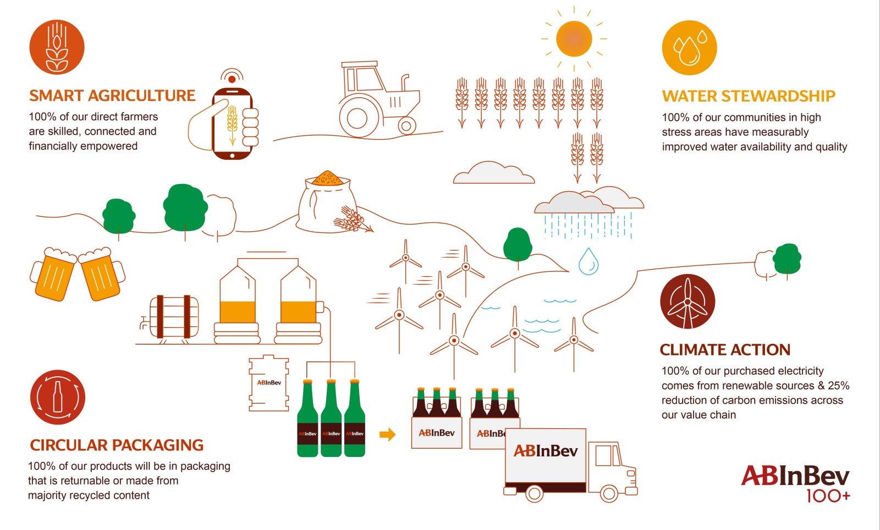
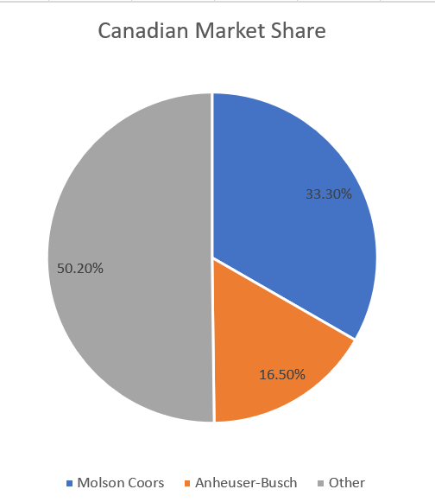
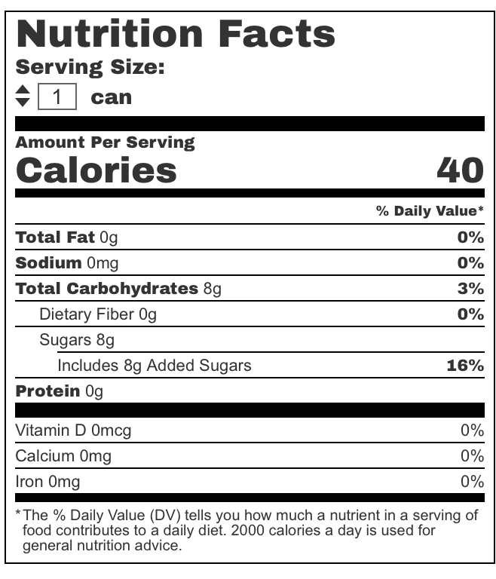
Cooperative Strategy Analysis
Molson Coors
April 2020; partnered with HEXO CORP to develop non-alcoholic, cannabis-infused beverages
Largest Canadian Cannabis drink manufacturer
Stock price has jumped 14% in 2021
Competitive Advantage: Market Share and Growth
Anheuser Busch
In October of 2020, Anheuser Busch partnered with Rio Tinto to manufacture zero carbon aluminum beer cans.
Multinational Mining Company
Reduce Carbon Emissions by 30%
Competitive Advantages: Sole partner and First to do this
Notes:
Competitive advantage 1:
Market share: Hexo corp already has majority of the Canadian cannabis market from a previous deal with a company called Redecan. Molson holds majority share of the Canadian beer market.
Competitive advantage 2:
Projected market growth for CBD products: In the U.S. alone, expected growth for non alcoholic, CBD infused beverages will increase by 75% average annual growth rate between 2018 to 2023. Molson holds the second highest share of the U.S. beer market.
Competitive Advantage #1:
Exclusive sole partner of one of the largest recycled aluminum manufacturers in the world. Rio Tinto has been around for approximately 110 years.
Competitive Advantage #2:
Recyclable Aluminum cans will debut with Anheuser-Busch cans, becoming first in the market and beating out Molson Coors.

Slide 12

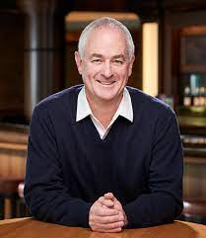
Corporate Governance Analysis
Molson Coors
14 board of directors
Peter H. Coors, Chairman of the Board
Gavin D. Hattersley CEO
Board is independent
Stock price - $46.46
Better for Small Investor
Better for Non-Investors using data from glassdoor.com
Anheuser-Busch
15 board of directors
Martin Barrington (Former CEO of Altaria Inc.)-Chairman of Board
Brandon Whitworth CEO
Board is not independent
Stock price - $57.83
Concentration of Ownership
Concentration of Ownership
Dodge & Cox - 15.66%
The Vanguard Group, Inc. - 9.46%
BlackRock Fund Advisors - 4.9%
SSgA Funds Management, Inc. - 4.14%
Clarkston Capital Partners LLC - 3.09%
Stichting Anheuser-Busch InBev - 39.2%
Eugenie Patri Sebastien SA - 7.72%
Anheuser-Busch InBev SA/NV - 2.78%
BRC Sàrl - 2.35%
Norges Bank Investment Management - 1.42%
Notes:
Board is independent:
Restated Certificate of Incorporation contains provisions intended to ensure that at all times a majority of directors are independent
9 independent board of directors
Board is not independent:
There are only 3 independent directors on the board
9 members of the board reside as Stichting Anheuser-Busch InBev board members
3 board members including the chairman Barrington are members appointed by the restricted shareholders

Slide 13
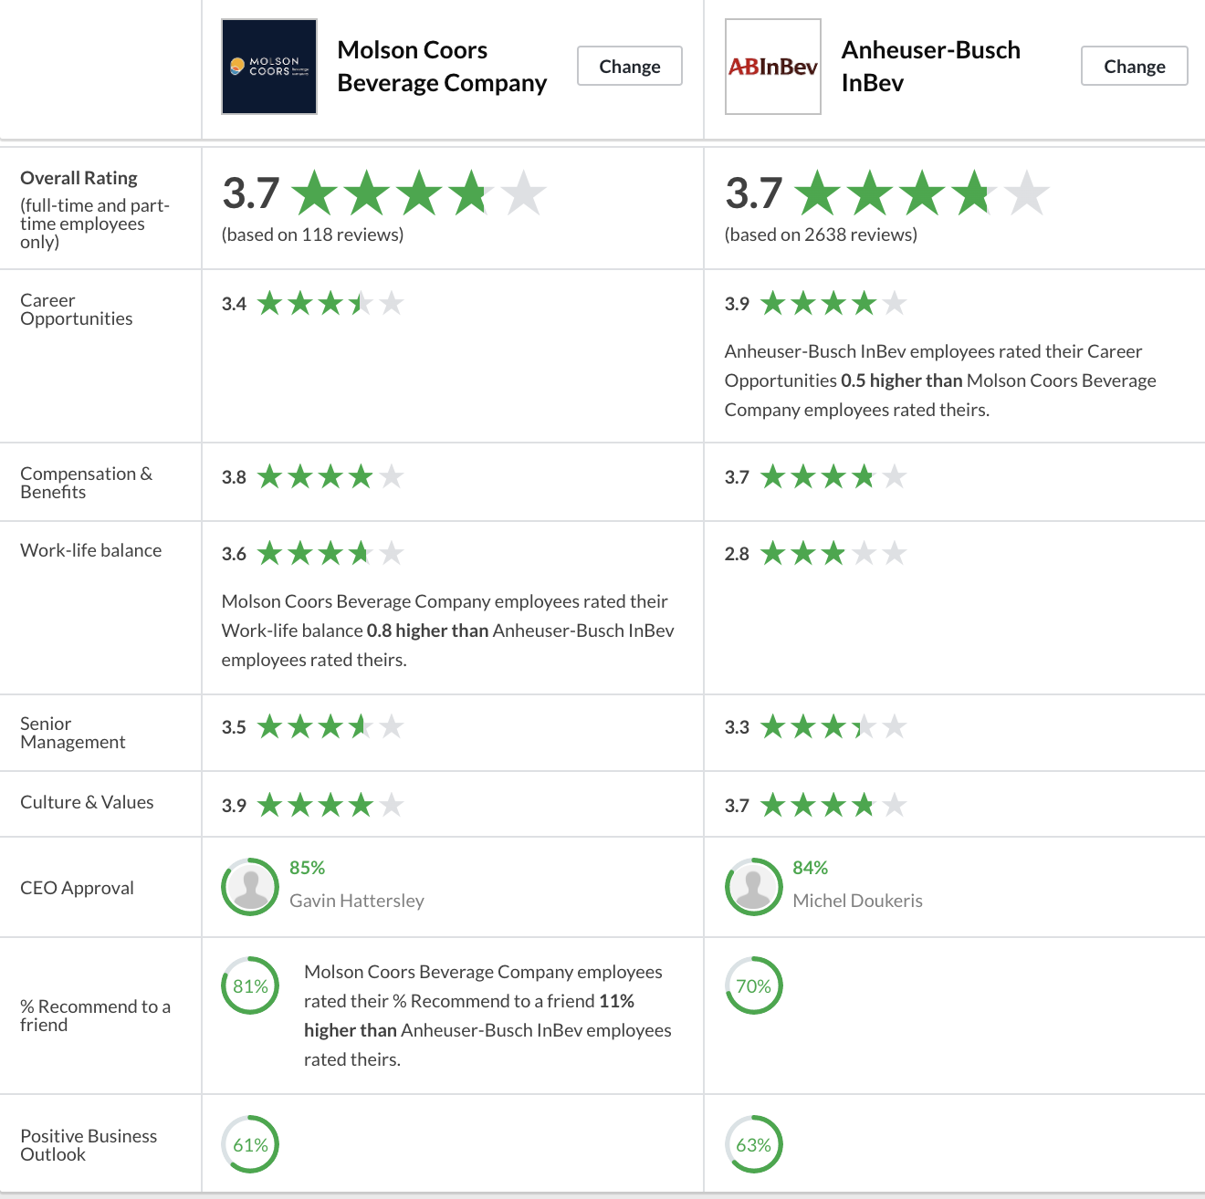
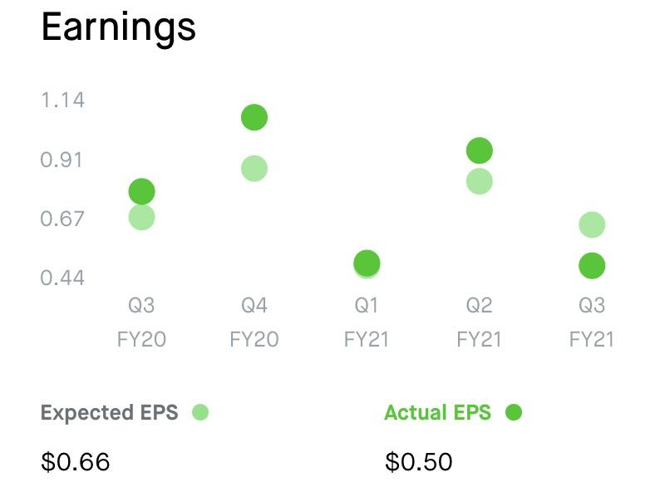
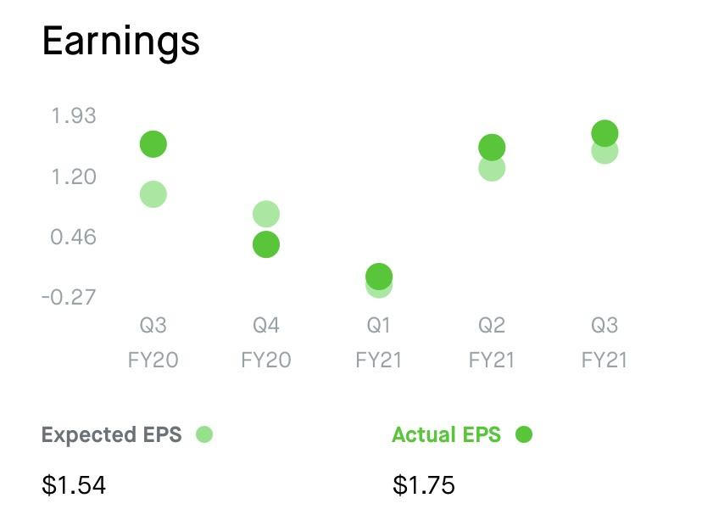
Corporate Governance Analysis Continued
Busch EPS
Coors EPS

Slide 14
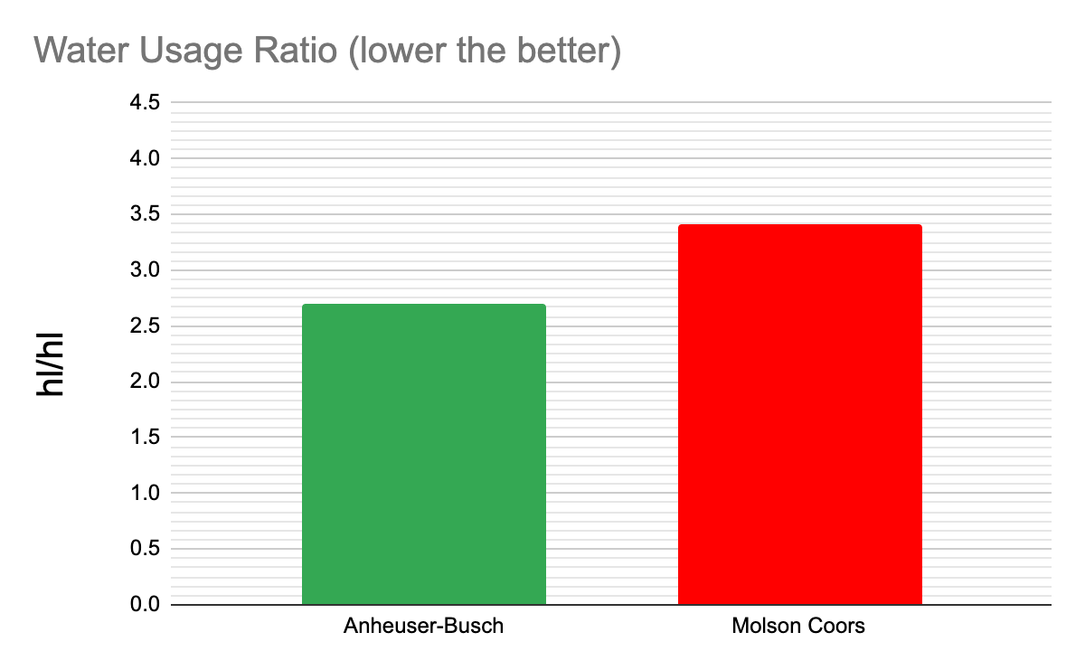
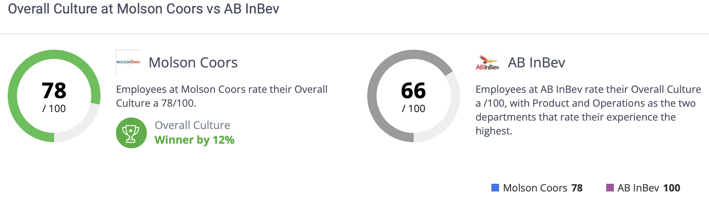
Corporate Performance Management Analysis
Consumers : product quality
Employees : workplace culture
Community : water/beer ratio
Product rating : Molson Coors (left) vs AB InBev (right)
Notes:
3 core groups that a corporation serves outside of financial stakeholders.
Consumers, employees and the community.
we’ll start with the consumers.
We use product quality as the measure because quality dictates the consumers perception of the product.
I.e. how well the product serves the consumer.
As you can see from the picture displaying each companies product rating, Busch has the higher rating showing its better at serving the consumers.
For employees we use work place culture as the measurement because a healthy work place a direct indicator of the effort each company gives it’s employees.
According to the ratings attached, Coors is the better company to work for and is therefore better at serving its employees.
Finally we have the community as a whole.
We use the water to beer ratio because, Water is essential to the community but it’s also the main component of beer.
@ 2.7hl/hl of water, busch has less of an impact on the environment and the community
Conclusion: with busch outranking coors in ⅔ categories, they are the better company w/ respect to company performance.

Slide 15
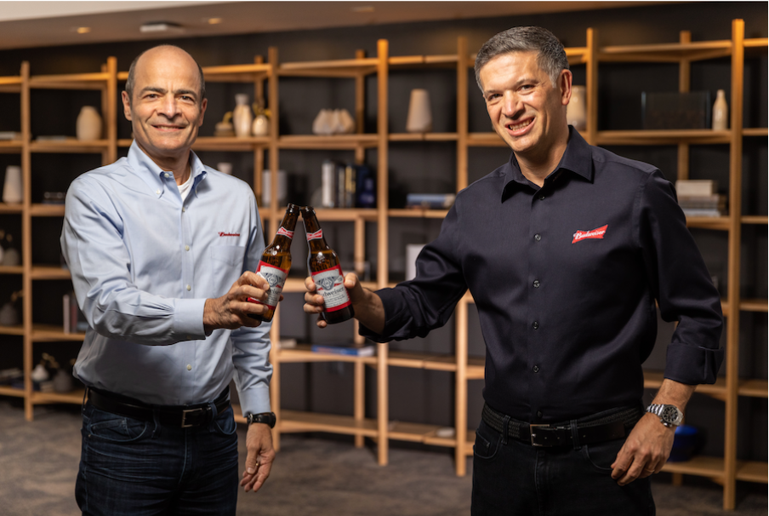

Strategic Leadership Analysis
CEO Succession:
Busch: (internal hire)
Coors: (internal hire)
Change in firm’s strategy: Busch
Diversity → minimal
Business strategy → significant
Change in firm’s strategy: Coors
Diversity → minimal
Business strategy → minimal
Notes:
Week 12.
Both busch and coors have recently undergone a change in ceo
For busch it was the internal hire of the ceo Mike doukeris on July of this year.
Changes brought about to strategy
Prior to Change: Busch leadership was Homogenous w/ (gender and age) but heterogeneous in educational backgrounds
After the change, leadership remained homogenous in age and gender with the exception of 1 additional female hire.
Educational backgrounds remained heterogenius.
However not everything remained the same
Doukeris brought a Direct-to-Consumer strategy with the first company e-commerce platform.
In 2021, DTC revenue surpassed 1 billion, with e-commerce as the largest contributor
As for Coors, the most recent change was the internal hire of gavin Gavin Hattersley in september 2019.
Prior to the change, coors leadership was heterogeneous in age and education but homogenous for gender
After the change in ceo, diversity in leadership remained the same.
As for strategy, Hattersley has implemented a partnership and growth strategy which has so far, increased net sales by 2.5%

Slide 16
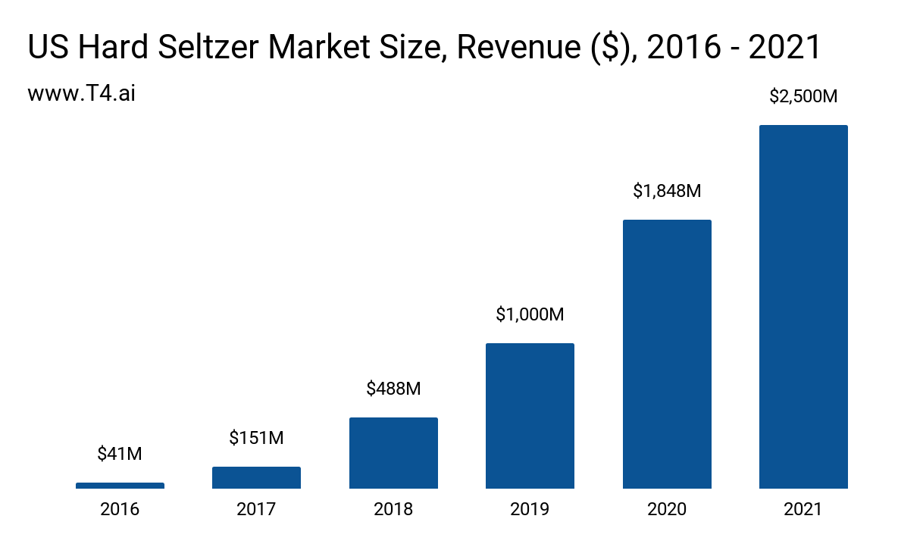
Strategic Entrepreneurship Opportunities
Expand into the seltzer market
Seltzer market challenges
Product innovation
Notes:
The global hard seltzer market is expected to grow at a compound annual growth rate of 16.2% from 2022 to 2027 to reach USD 14.51 billion by 2027. Both companies need to take advantage of this opportunity.
Getting into an already niche market is hard to do as Molson Coors has already failed once attempting to get into the seltzer market with their Coors Seltzers.
Molson Coors can try to innovate their seltzers to stand out among their competitors such as White Claw and Truly. This can include offering new flavors or changing the contents of the seltzers to make them more marketable.

Slide 17
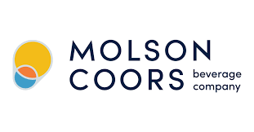

Summary
Competitive advantages are crucial in competing with rivals
The Board of Directors needs to favor the shareholders
International strategy is important for expansion
Corporate strategy combined with strategic leadership guides the company
Notes:
Anheuser Busch has the competitive advantage over Molson Coors which is why Anheuser is more successful. Anheuser has more plants, cash, and inventory which is currently giving them a leg up when compared to Molson Coors.
There should always be more outside directors than inside directors. A good makeup of the board would include 2 inside directors and the rest outside.
Anheuser Busch gains almost 70% of its revenue from international sales. Molson Coors international revenue makes up only about 30% of its revenue. International strategies can give one company an advantage over the other.
The top directors of each company need to have a strategy for leading their company as well as the leadership capabilities to make sure everyone in the company is pushing towards the same goal. Companies with a clear plan and employees on the same page generally are more successful.

Slide 18
Sources
https://www.beveragedaily.com/Article/2021/07/12/Molson-Coors-discontinues-Coors-Seltzer-in-the-US#:~:text=Molson%20Coors%20launched%20Coors%20Seltzer,for%20a%20trusted%20beer%20brand'
https://www.goodbeerhunting.com/sightlines/2020/11/13/molson-coors-shifts-from-internal-innovation-to-external-partnerships
https://foodinstitute.com/focus/why-is-hard-seltzer-so-popular-with-consumers/
https://www.fooddive.com/news/molson-coors-ending-production-of-coors-seltzer-brewbound-reports/603081/
https://www.forbes.com/sites/katedingwall/2021/08/18/anheuser-busch-pushes-sustainability-hard-seltzer-innovation-with-new-los-angeles-brewery-investment/?sh=707ac6364ef3
https://montrealgazette.com/business/local-business/molson-coors-betting-100-million-on-seltzer-to-expand-beyond-beer-in-canada
https://www.abwholesaler.com/common/wholesaler-locator/
https://www.marketingdive.com/ex/mobilemarketer/cms/news/software-technology/15702.html
https://ir.molsoncoors.com/overview/default.aspx
https://www.anheuser-busch.com/about.html
https://csimarket.com/stocks/markets_glance.php?code=TAP
https://smallbusiness.chron.com/beer-industry-legal-political-factors-75952.html
http://fernfortuniversity.com/term-papers/pestel/nyse4/587-anheuser-busch-inbev-sa-nv.php
https://www.comparably.com/competitors/ab-inbev-vs-molson-coors
https://www.ab-inbev.com/news-media/news-stories/anheuser-busch-inbev-announces-ceo-succession/
https://www.reuters.com/companies/BUD/people
https://www.reuters.com/companies/TAP/people

Slide 19
Introduction - summarize/visualize the roadmap of the entire presentations
Week 1 Stephanie
Week 2 Stephanie
Week 3 Archer
Week 4 Archer
Week 5 Matt W
Week 6 Matt W
Week 7 Matthew R
Week 8 Matthew R
Week 9 Michael
Week 10 Michael
Week 11 Clio
Week 12 Clio
Week 13 Ryan
last slide should present a summary Ryan
o Summarize each week’s presentations into one slide of visualization
The first slide should summarize/visualize the roadmap of the entire presentations
Each slide should contain no more than 5 bullet points in big fonts
Each slide should have a picture, chart, or image that captures the essence of the idea
Include your scripts in the note area, plus any other notes about this slide
The last slide should present a summary about what you have learned the most from this project

